Slide 1
Deep Inspection
Contractor: Example Contractor
Client: Example Client
Agreement #111-11-11 dated 01.11.2024
Structure type F6
Construction count: 2 pcs.
Installation address: Sample District, Example Street 137A, pedestrian area
Reporting period: 01.12.2024-31.12.2024

Slide 2
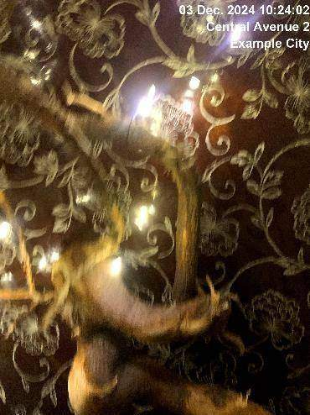
03.12.2024
Construction 3
Deep inspection required

Slide 3
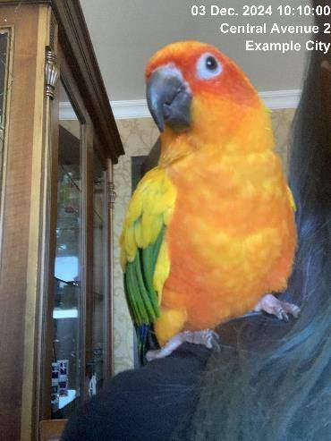
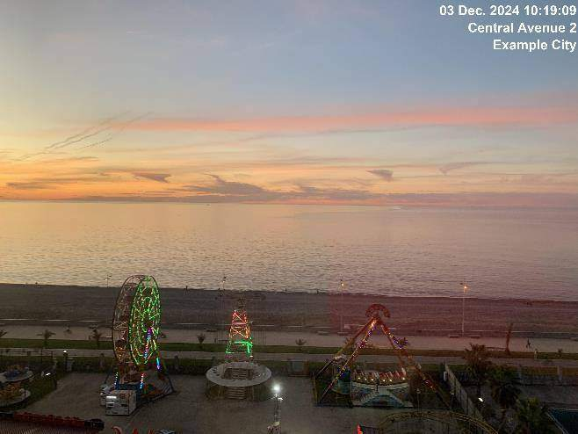
03.12.2024
Construction 3
Electrical components replaced

Slide 4
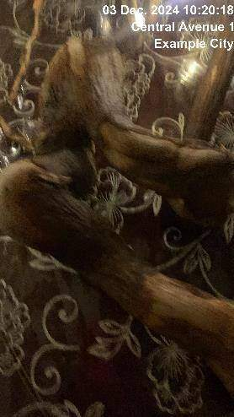
03.12.2024
Construction 3
Issue resolved

Slide 5
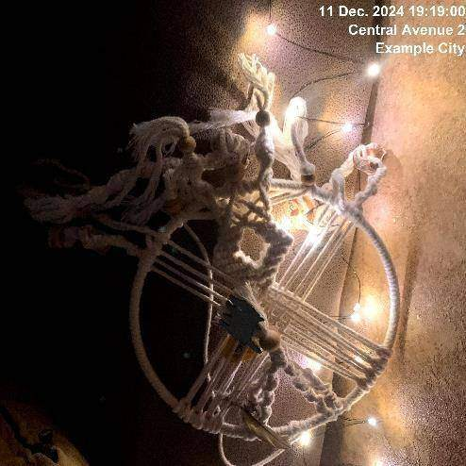
11.12.2024
Construction 2
Deep inspection required

Slide 6
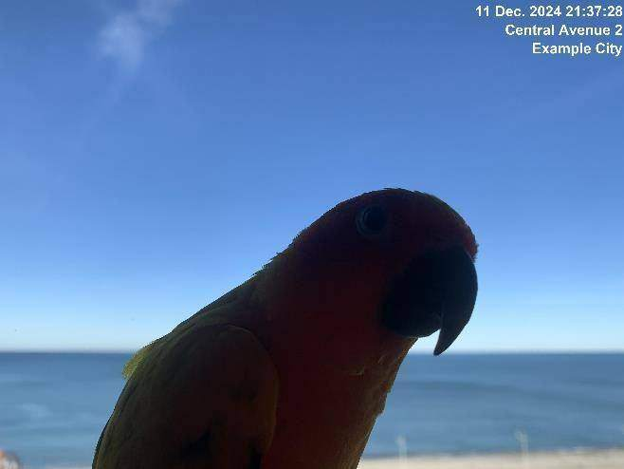
11.12.2024
Construction 2
Electrical components replaced

Slide 7
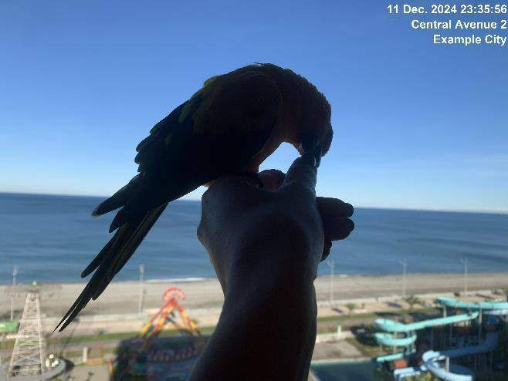
11.12.2024
Construction 2
Electrical components replaced

Slide 8
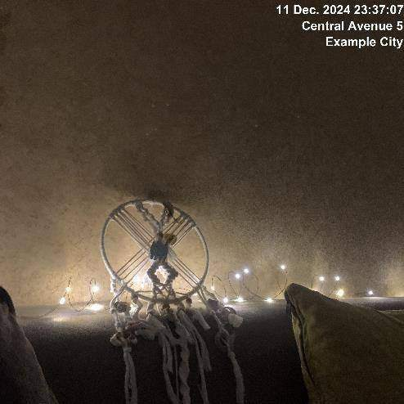
11.12.2024
Construction 2
Issue resolved

Slide 9
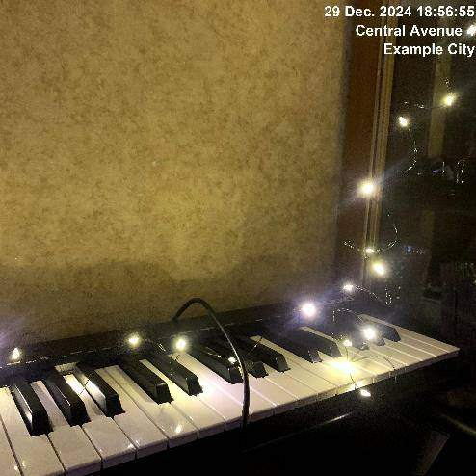
29.12.2024
Construction 1
Deep inspection required

Slide 10
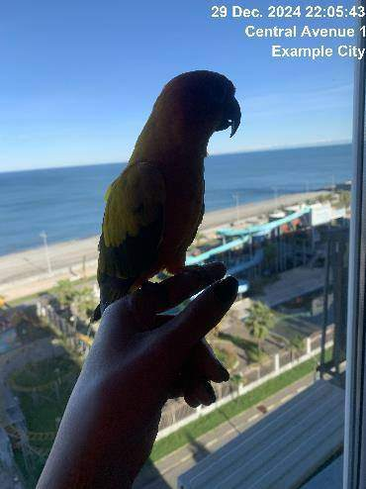
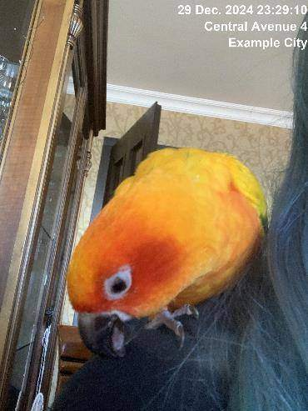
29.12.2024
Construction 1
Electrical components replaced

Slide 11
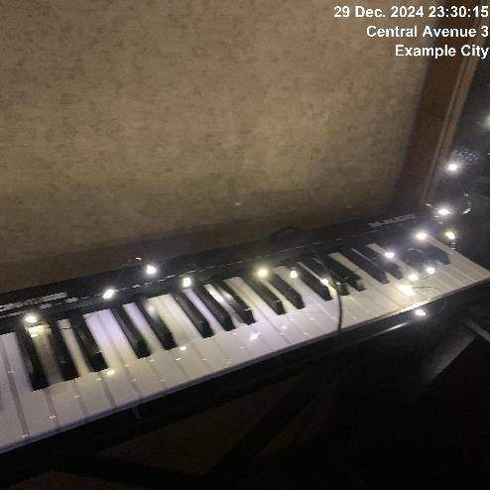
29.12.2024
Construction 1
Issue resolved

